Slide 1
MERN Full Stack Development
Gayatri S

Slide 2
TOC
MERN Tools and Technologies
Introduction to Node JS with server implementation
Introduction to ReactJS with UI implementation
Introduction to MongoDB with NoSQL syntax
Demo with hands- on coding experience

Slide 3
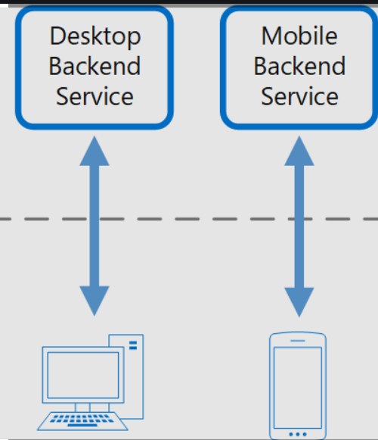
Frontend and Backend

Slide 4
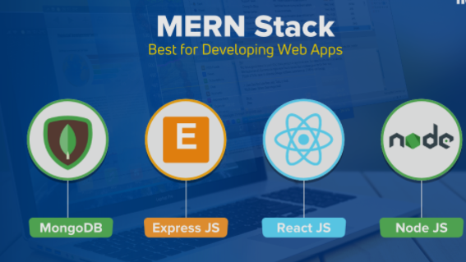
MERN

Slide 5
Frontend/Client -> ReactJS
Backend/Server -> NodeJS with Express Framework and MongoDB
API -> Application Program Interface
JSON - > JS Object Notation.
{ id:1 , city:”Kochi” , country : “India” }

Slide 6
ReactJS
JS library for building UI
Components
https://github.com/facebook/create-react-app
SPA

Slide 7
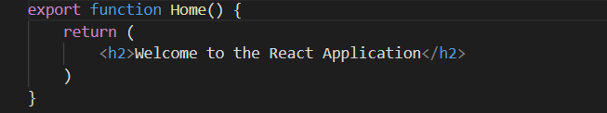
Function Components

Slide 8
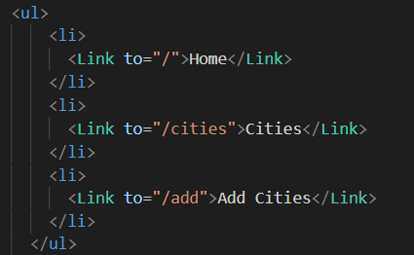
Built in tags and React components

Slide 9
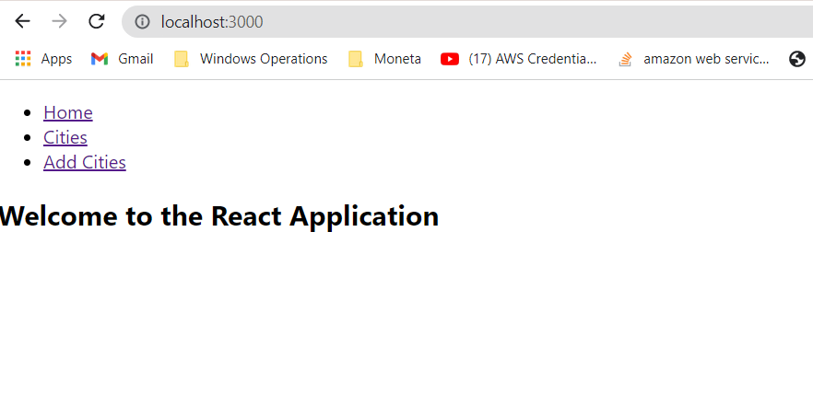
Demo UI - Home

Slide 10
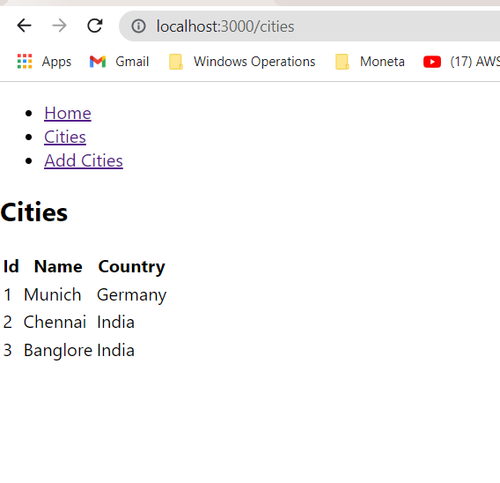
Demo UI - Lists

Slide 11
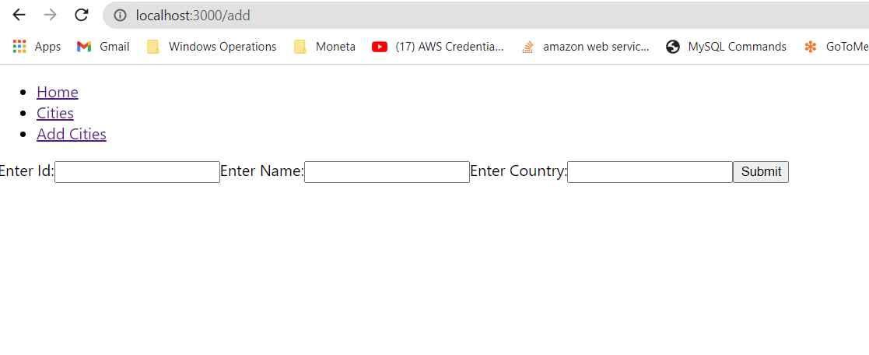
Demo UI -Add Cities

Slide 12


Slide 13
NodeJS - Server side Javascript
V8 is an open source JS engine developed by Google.
Node JS runs on V8
It was created by Ryan Dahl in 2019
It is an open source.
Node is high performance network application framework

Slide 14
NPM
NPM is Node Package Manager, CLI (Command Line Interface)for managing your node modules
It maintains the packages or node modules
To install a package you just need to do “npm install <package name>”
It will install latest version of that package in your system.

Slide 15
Asynchronous and Synchronous
alert(1);
setTimeout(() => alert(2), 0);
alert(3);
// Synchronous: 1,2,3
alert(1);
setTimeout(() => alert(2), 0);
alert(3);
// Asynchronous: 1,3,2

Slide 16
Non Blocking
// Blocking
const fs = require('fs');
const data = fs.readFileSync('/file.md'); // blocks here until file is read
console.log(data);
moreWork(); // will run after console.log
// Non-blocking
const fs = require('fs');
fs.readFile('/file.md', (err, data) => {
if (err) throw err;
console.log(data);
});
moreWork(); // will run before console.log

Slide 17
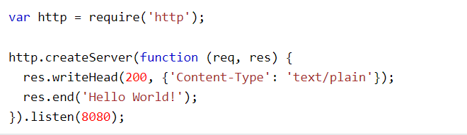
Easy way to create server using http or express

Slide 18
When to use NodeJS?
Node JS is used for creating streaming based real time services, web chat applications, static file servers etc
If you are great at writing JS code because then you can use the same language at both places: server-side and client-side.
High performance e-commerce applications

Slide 19
Some Good Modules
Express - > is a framework, to make things simpler.It makes routing easy for API’s, Helps to set up middlewares , middleware is a function which receives request and response objects.
Socket IO -> to create chat applications or realtime app
Http -> allows NodeJS to transfer data over the HTTP.
FS-> allows you to work with the file system on your computer

Slide 20
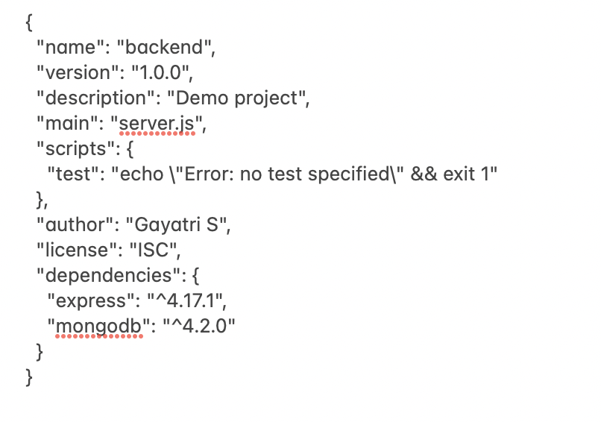
Package.json

Slide 21


Slide 22
MongoDB - NoSQL Database
Open source NoSQL database management program.
A tool that can manage document-oriented information, store or retrieve information.
MongoDB uses JSON-like documents with optional schemas.
MongoDB is developed by MongoDB Inc. and licensed under the Server Side Public License.

Slide 23
Issues with traditional DB
Scalability - difficult to scale
Flexibility - difficult to make modification.
Performance - complex caching mechanism

Slide 24
MongoDB
It is NoSQL database or document database
It stores data in JSON format. So that it is easy to make API in JSON.
Highly scalable and flexible because there is no JOINS needs to perform.
If you want to relate a particular data we just embed that data as a sub document in document structure.

Slide 25
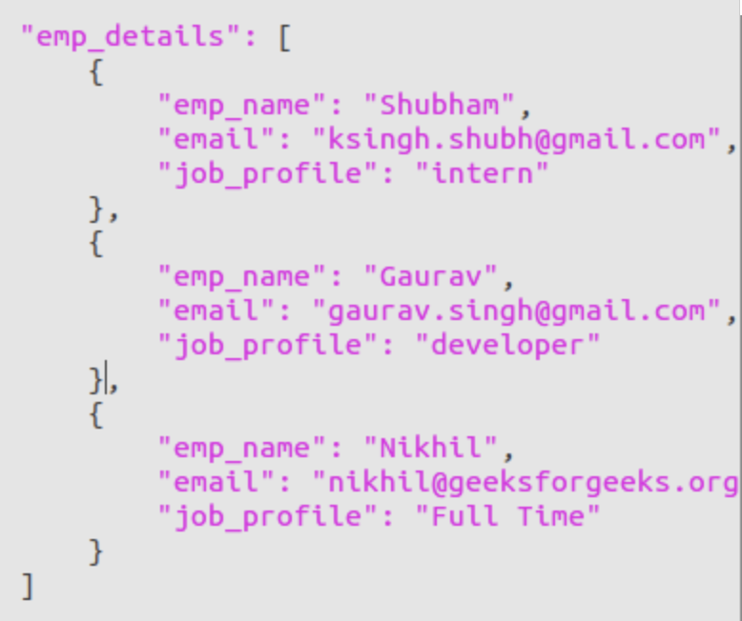
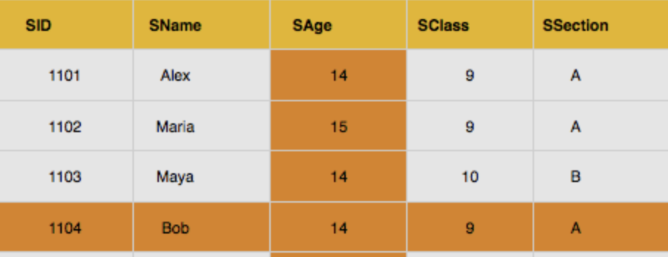
MongoDB vs RDBMS

Slide 26
SQL vs MongoDB
SQL | MongoDB
Database | Database
Table | Collection
Index | Index
Row | Document
Column | Field
Joining | Embedding

Slide 27
Mongo Shell Commands and CRUD
show dbs
use <db>
show collections
show users CRUD Operations
db.collection.find()
db.collection.findOne(<query>)
db.collection.insertOne()
db.collection.insertMany()
db.collection.updateOne()
db.collection.updateMany()
db.collection.deleteOne()
db.collection.deleteMany()

Slide 28


Slide 29
Reference
https://reactjs.org/docs/getting-started.html
https://www.taniarascia.com/getting-started-with-react/ https://docs.mongodb.com/v4.4/crud/
https://www.w3schools.com/nodejs/nodejs_mongodb.asp
https://nodejs.org/en/docs/
https://expressjs.com/

